Slide 1
Run 7232 Efficiency Results
ICARUS Data-Driven Trigger Efficiency Measurement
Tanvi Krishnan
SLAC SULI Intern 2022

Slide 2
Motivation
The ICARUS detector collects hundreds of terabytes of data daily
The trigger system filters and keeps only the most interesting events, reducing the amount of data storage required
It is important to study the efficiency of the trigger in order to select the optimal level of filtering for the trigger
We plotted the efficiency as a function of different track characteristics (length, energy, starting and ending x coordinate, starting z coordinate)
We plotted the efficiency under different simulated trigger settings:
M1: 1 PMT pairs trigger S3: 3 PMT pairs trigger
S5: 5 PMT pairs trigger S8: 8 PMT pairs trigger
S10: 10 PMT pairs trigger S15: 15 PMT pairs trigger
M1 is the least restrictive, requiring only 1 PMT pair to detect light above the minimum threshold to trigger
S15 is the most restrictive, requiring 15 PMT pairs to detect light above the minimum threshold to trigger

Slide 3
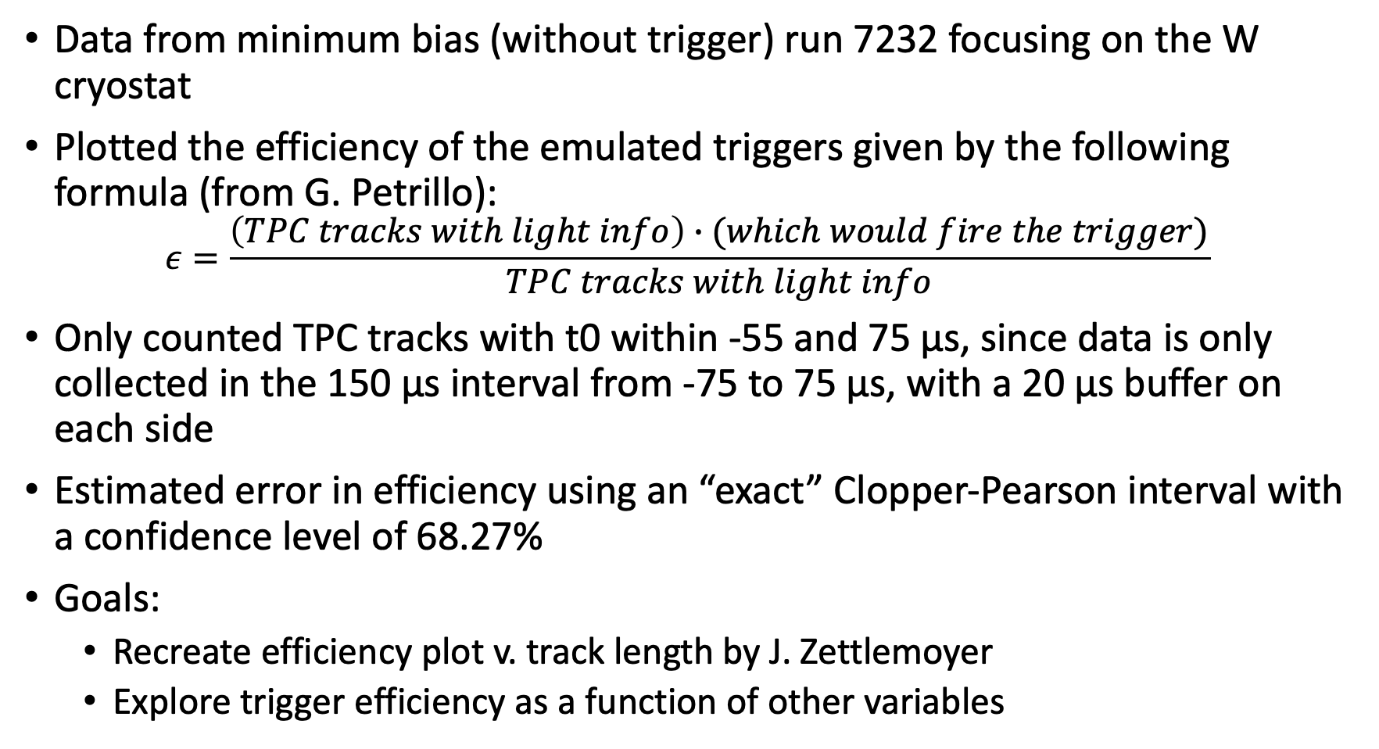
Methods
Data from minimum bias (without trigger) run 7232 focusing on the W cryostat
Plotted the efficiency of the emulated triggers given by the following formula (from G. Petrillo):
$$ε=\frac{\left(TPC tracks with light info\right)∙(which would fire the trigger)}{TPC tracks with light info}$$
Only counted TPC tracks with t0 within -55 and 75 µs, since data is only collected in the 150 µs interval from -75 to 75 µs, with a 20 µs buffer on each side
Estimated error in efficiency using an “exact” Clopper-Pearson interval with a confidence level of 68.27%
Goals:
Recreate efficiency plot v. track length by J. Zettlemoyer
Explore trigger efficiency as a function of other variables

Slide 4
Efficiency Plots
Using reconstructed cathode-crossing tracks from a minimum-bias data run with different trigger emulations, comparing East and West cryostats

Slide 5
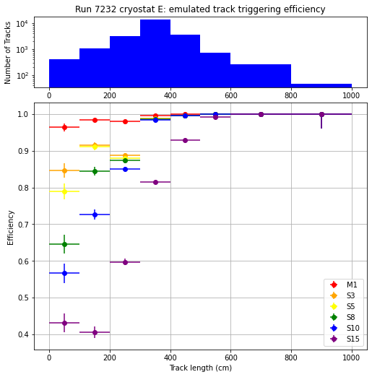
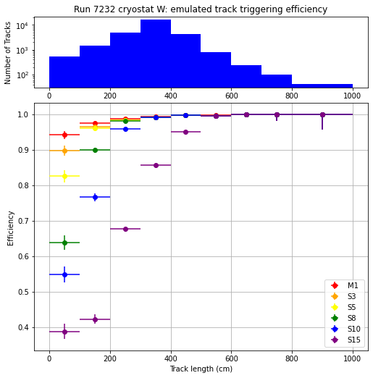
Trigger Efficiency for varying track length
There were very few (<0.05%) tracks longer than 1000 cm, so I focused on tracks shorter than 1000 cm. These plots use a 68.27% Confidence Interval.
West Cryostat
East Cryostat

Slide 6
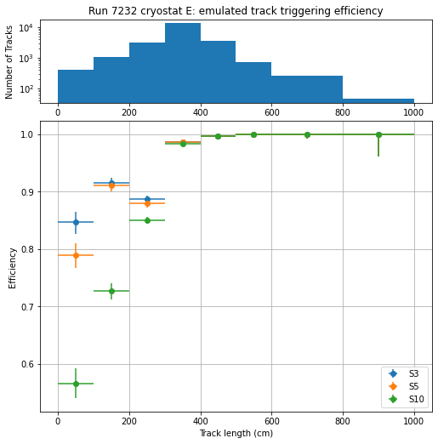
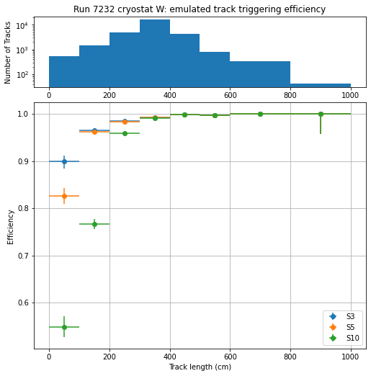
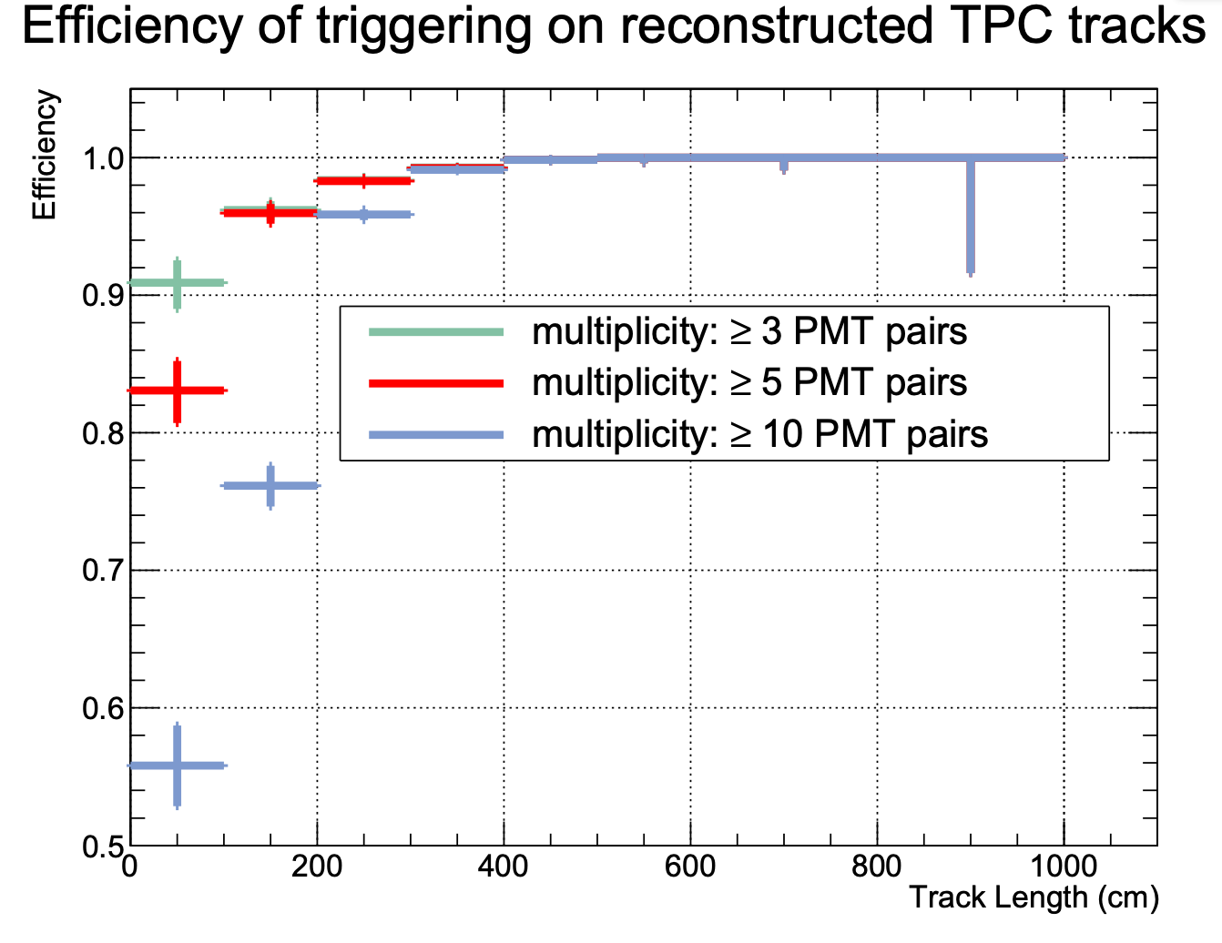
Trigger Efficiency for varying track length
I used this work to recreate a plot of trigger efficiencies by J. Zettlemoyer (SBN DocDB 26671). It appears that he used the data from the West cryostat, which matches well albeit slight variations in the magnitude of the error bars, as he probably used a different method for these calculations

Slide 7
Trigger Efficiency for varying track length
In the both cryostats there’s a drop in efficiency of the emulated triggers for track lengths around 200-240 cm

Slide 8
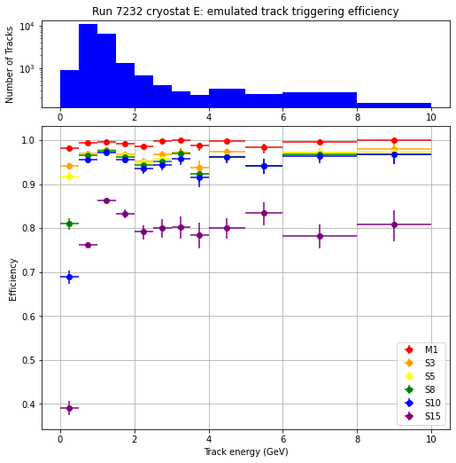
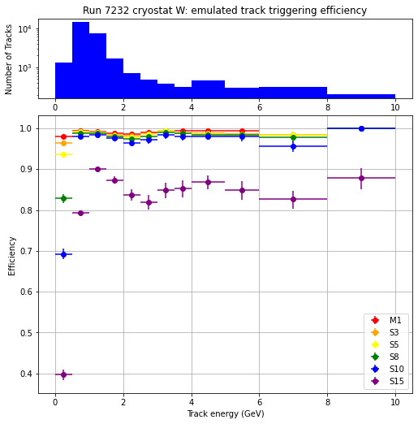
Trigger Efficiency for varying track energy
Track energies varied from 37 MeV to 1.4 TeV, but there were very few (<2%) tracks with more than 10 GeV of energy, so I focused on tracks with less than 10 GeV of energy

Slide 9
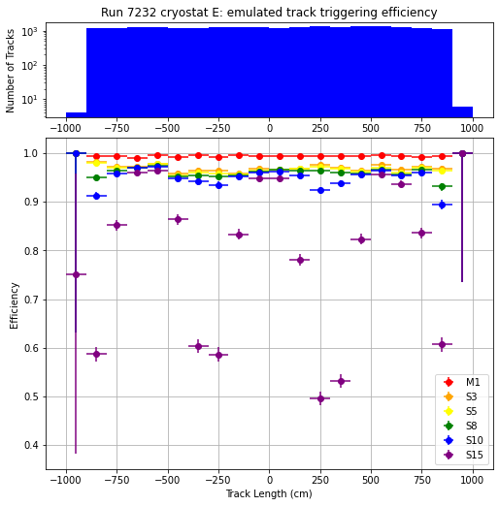
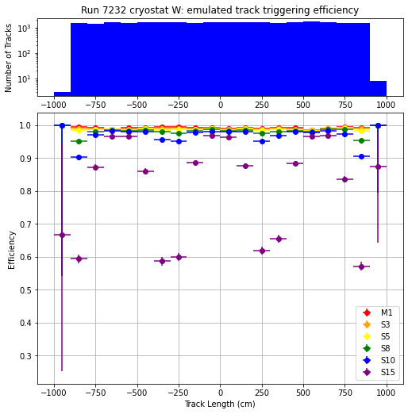
Trigger Efficiency for varying starting z-position of Tracks
Starting z-position varied from about -900 cm to 900 cm and appears to be roughly evenly distributed. The efficiency appears to have 3 peaks, most clear for S15 data. This makes sense as the trigger emulation used for this dataset has 3 sections of the cryostat along the z-axis, so efficiency is highest in the centers of those sections. The sliding door setup should eliminate this issue.

Slide 10
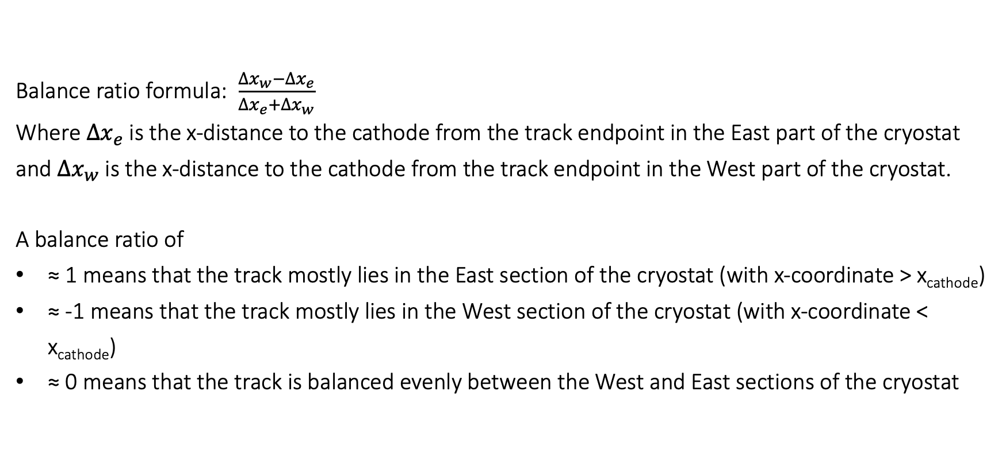
Trigger Efficiency as a function of the x-directional balance of tracks on either side of the cathode
Balance ratio formula: $\frac{∆x_{w}−∆x_{e}}{∆x_{e}+∆x_{w}}$
Where $∆x_{e}$ is the x-distance to the cathode from the track endpoint in the East part of the cryostat and $∆x_{w}$ is the x-distance to the cathode from the track endpoint in the West part of the cryostat.
A balance ratio of
≈ 1 means that the track mostly lies in the East section of the cryostat (with x-coordinate > x_{cathode})
≈ -1 means that the track mostly lies in the West section of the cryostat (with x-coordinate < x_{cathode})
≈ 0 means that the track is balanced evenly between the West and East sections of the cryostat

Slide 11
Trigger Efficiency as a function of the x-directional balance of tracks on either side of the cathode
A balance ratio of
≈ 1 means that the track mostly lies in the East section of the cryostat (with x-coordinate > x_{cathode})
≈ -1 means that the track mostly lies in the West section of the cryostat (with x-coordinate < x_{cathode})
≈ 0 means that the track is balanced evenly between the West and East sections of the cryostat

Slide 12
Trigger Efficiency for varying track length for tracks primarily on one side of the cathode or the other
Do I need this?

Slide 13
Trigger Efficiency for varying track energy for tracks primarily on one side of the cathode or the other
Do I need this?

